Slide 1
SDG 13: CLIMATE ACTION • HHS HACKATHON 4
30-Second AI Film Prototype
Through the Glass
A Timeline of Inaction — 500 years of environmental decay viewed through one unchanging window.
VIDEO
Engineered with ComfyUI • SDXL + ControlNet Canny + AnimateDiff
The Hague University of Applied Sciences

Slide 2
CRITERION 1: PROBLEM DEFINITION
The Psychology of Climate Inaction
FACTUAL ANCHOR
COGNITIVE BIAS
BARRIER TO ACTION
IPCC AR6 Mandate
Temporal Discounting
The Fatalism Trap
Global emissions must drop 43% by 2030 to prevent breaching 1.5°C warming.
Catastrophes perceived as centuries away delay immediate civic accountability.
Sensationalist doomscrolling triggers eco-paralysis instead of meaningful agency.
SDG Target 13.3: Improve education, awareness-raising, and human capacity on climate change mitigation.

Slide 3
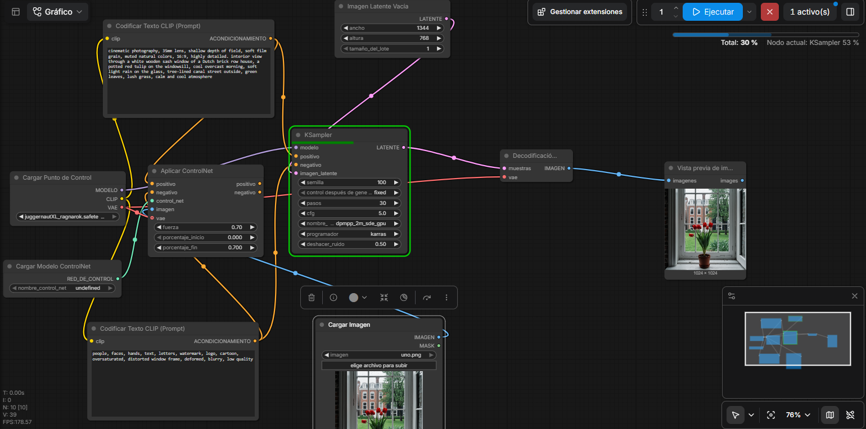
WORKFLOW 1: TEXT TO IMAGE:
Notes:
This workflow creates the key frame that anchors every shot. Juggernaut XL generates the image from a positive prompt, while the negative prompt removes people, text, logos, deformation, and blur. ControlNet uses the loaded reference image to hold the window geometry in place. The KSampler runs for 30 steps with CFG five, a Karras schedule, and 0.5 denoise. Changing the environment prompt creates a new era without losing the same viewpoint.

Slide 4
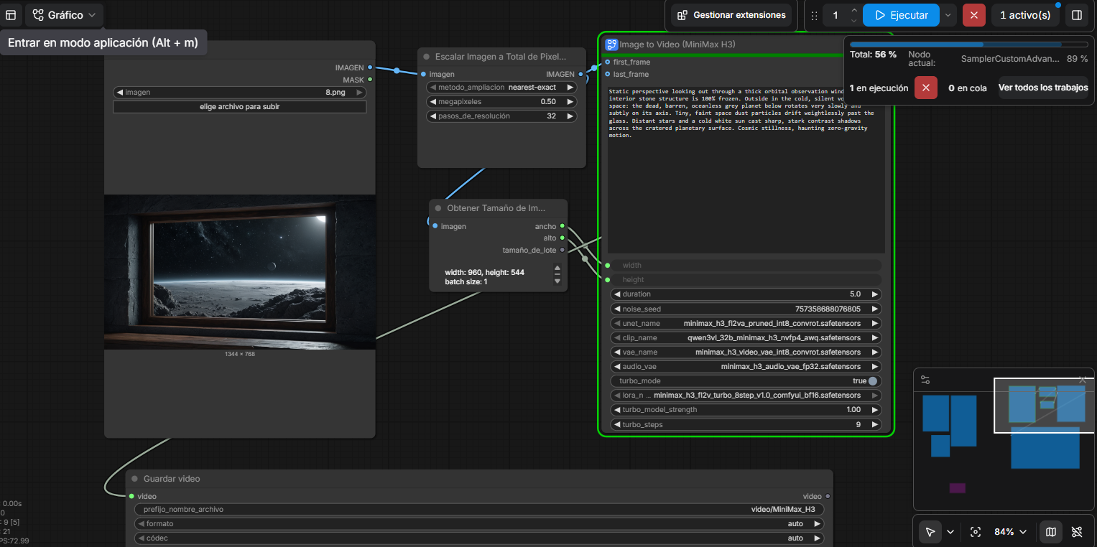
WORKFLOW 2: IMAGE TO VIDEO:
Notes:
This workflow turns a generated still into a five-second clip. The input image is resized to half a megapixel, and its width and height are passed into the MiniMax H3 image-to-video node. The prompt asks for subtle motion outside the window while the interior stays fixed. We use the same image as the first frame, run nine turbo steps, and save the result as an MP4. This preserves the window composition while animating smoke, rain, stars, or debris.

Slide 5
CRITERION 2: TARGET AUDIENCE
Quantified Demographic: 10,382,400 Students
METHODOLOGICAL FORMULA
WHO IT IS FOR (Target Segment)
10.38M
Higher education students (18–24) in the EU who accept climate science but remain paralyzed by fatalistic eco-anxiety.
18,540,000 students × 56% fatalism rate
WHO IT IS NOT FOR (Explicit Exclusion)
Data sources: Eurostat 2023/24 tertiary student registry & The Lancet Planetary Health (Hickman et al., 2021).
Climate deniers (unpersuadable in 30s) and children under 12 (catastrophic imagery causes unnecessary distress).
Campaign Placement: European Youth Climate Weeks across university digital boards, Instagram Reels, and YouTube Shorts.

Slide 6

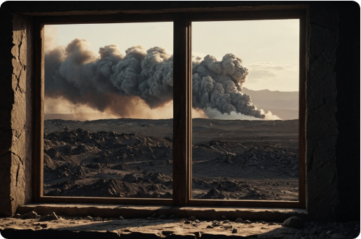
CRITERION 4: PROBLEM-SOLUTION FIT
The Unmoving Window Sill Anchor
1. Temporal Compression
500 years collapsed into 30 seconds to dissolve perceived psychological distance.
2. Spatial Anchor
The static stone sill places the viewer in the room as an active historical observer.
3. Shattering Doomism
Proves today is the singular point on the timeline where outcomes can be altered.
Design Strategy: 100% locally rendered video pipeline engineered specifically for high-retention short-form media.

Slide 7
CRITERIA K1 & 5: AI PIPELINE & WORKING PROTOTYPE
Deterministic ComfyUI Workflow Architecture
NODE 01: FOUNDATION
NODE 02: STABILITY
NODE 03: MOTION
NODE 04: ISOLATION
SDXL Checkpoint
ControlNet Canny
AnimateDiff-Evolved
Latent Mask Inpaint
Juggernaut XL delivers photographic realism, rock texture, and atmospheric haze.
Locks stone sill edges at 0.85 weight, preventing geometric morphing across centuries.
Synthesizes continuous smoke plumes, acid rain trails, and volcanic explosions.
Mutates exterior window view at 0.75+ denoise while interior walls remain untouched.
Submitted Artifact: workflow_through_the_glass.json
✓ 100% Deterministic & Reproducible

Slide 8
CRITERION 3: SOLUTION DESCRIPTION
30-Second Storyboard & Temporal Schedule
SHOT | TIMECODE | ERA | ENVIRONMENTAL DYNAMICS | SETTINGS
01 | 00:00 - 00:04 | Year 1800 | Pristine ancient virgin forest, crystal river, morning sunlight. | Canny: 0.85
02 | 00:04 - 00:08 | Year 1900 | Industrial brick smokestacks, dense soot, muddy riverbank. | Canny: 0.85
03 | 00:08 - 00:13 | Year 1970 | Petrochemical flare stacks, yellow-brown smog, toxic rain. | Canny: 0.85
04 | 00:13 - 00:18 | Year 2100 | Blade Runner megacity, electronic waste, flying spinners, neon haze. | Inpaint: 0.80
05 | 00:18 - 00:24 | Year 2200 | Massive extinction crater explosion, billowing shockwave and ash. | Canny: 0.90
06 | 00:24 - 00:30 | Year 2300 | Window floats in deep space, lifeless barren Earth in orbit. | Canny: 0.95
Zero stock footage or external generators: 100% created through local ComfyUI batch nodes.

Slide 9
CRITERION 6: MANDATORY ETHICAL REFLECTION
Ethics, Compute & Transparency
MISINFORMATION
CONSENT & LIKENESS
CARBON AUDIT
Speculative Narrative
Zero Human Biometrics
1.8 kWh / 0.72 kg CO₂eq
No real neighborhoods depicted as destroyed. Framing is explicitly speculative to avoid simulating fake news.
Zero human faces or likenesses sampled, eliminating unauthorized biometric training and cultural caricature.
42 iterations on RTX 4090. Compute justified by publishing workflow open-source to prevent redundant student tests.
Mandatory Attribution: On-screen watermark reads "AI Speculative Visualization for SDG 13" throughout the film.

Slide 10
CONCLUSION & DISCUSSION
HHS Hackathon 4 • Week 5
Key Takeaways from the Pipeline
Thank You
Geometry requires ControlNet: Text prompts alone cannot preserve architectural perspective across temporal prompts.
Ready for Questions & Evaluation
Denoise equilibrium: Values above 0.85 warp the interior sill; values below 0.50 prevent landscape degradation.
GitHub Repository & JSON Workflow Submitted
Narrative over spectacle: Anchoring the viewer inside one room converts visual effects into psychological empathy.
SDG 13: Climate Action • The Hague University of Applied Sciences
Pair Submission

